Slide 1

Unlocking the Potential: An Exploration of Homomorphic Encryption
ICS LCA Component
Presented By :
PC-43 Dittee Salian
PC-44 Tejas Redkar
PC-49 Gayatrini Neogi
PC-50 Atharva Chaher PC-63 Jinal Gulhane
PC-36 Navjot Singh Sidhu

Slide 2

Introduction
Homomorphic encryption is a powerful cryptographic technique that enables computation on encrypted data without the need for decryption.
In traditional encryption schemes, data needs to be decrypted before any operations can be performed on it.
However, homomorphic encryption allows computations to be performed directly on encrypted data, preserving its confidentiality.
The concept of homomorphic encryption was introduced by G. Andrew Neff in 1978, and it has since become an essential tool in the field of secure and privacy-preserving computation.

Slide 3

Understanding Homomorphic Encryption
Imagine you have an encrypted message (ciphertext) that represents a number.
With homomorphic encryption, you can perform mathematical operations (like addition or multiplication) directly on the ciphertext without decrypting it.
The result of the operation on the encrypted data is also encrypted, and when decrypted, it yields the same result as if the operation were performed on the plaintext.

Slide 4

Types of Homomorphic Encryption
Partially Homomorphic Encryption
Somewhat Homomorphic Encryption
Fully Homomorphic Encryption

Slide 5

Applications in Data Privacy
Homomorphic encryption is revolutionizing data privacy in healthcare, finance, and government sectors.
It enables secure data analysis and processing while preserving confidentiality.

Slide 6

Challenges and Limitations
Despite its potential,
homomorphic encryption faces challenges such as computational overhead and efficiency.
Overcoming these limitations is crucial for widespread adoption.

Slide 7
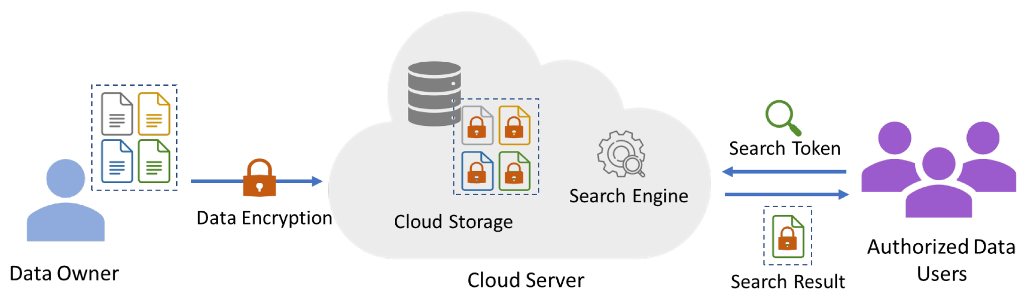
Advancements in Homomorphic encryption
Performance Improvements:
Ongoing efforts to improve the efficiency and speed of homomorphic encryption algorithms.
Optimization of cryptographic protocols to reduce computational overhead.
Hardware Acceleration:
Exploration of hardware-based solutions to accelerate homomorphic encryption operations.
Integration with specialized hardware, such as secure enclaves, for improved performance.

Slide 8

Homomorphic Encryption in Cloud Computing
Homomorphic encryption plays a significant role in enhancing the security and privacy of data in cloud computing environments. Cloud computing involves the storage, processing, and management of data on remote servers, and homomorphic encryption allows computations to be performed on encrypted data without decrypting it first.
Secure Data Processing:
Homomorphic encryption allows computations to be performed directly on encrypted data, preserving its confidentiality throughout the processing pipeline.
Cloud service providers can perform operations on client data without having access to the plaintext, enhancing privacy.
Confidential Data Sharing:
Users can securely share their encrypted data with cloud providers or other parties for specific computations without revealing the actual content of the data.
Enables collaboration on sensitive data without exposing it to third parties.

Slide 9

Homomorphic Encryption in Machine Learning
Homomorphic encryption in machine learning is a powerful approach that enables computations on encrypted data, preserving privacy and security.
Privacy-Preserving Data Analysis:
Homomorphic encryption allows machine learning algorithms to operate directly on encrypted data, ensuring the confidentiality of sensitive information.
Secure Model Training:
Enables secure model training in a collaborative environment where multiple parties contribute data without exposing the raw data to each other.
Outsourced Machine Learning:
Facilitates outsourcing of machine learning tasks to external service providers or cloud platforms while keeping the training data confidential.

Slide 10

Homomorphic Encryption and IoT
Homographic encryption enables:
Secure communication
Simple usage
Data processing
Ensuring privacy and confidentiality in connected devices and systems.
Secure Computation
Versatility in Applications
Adaptability in Various Algorithms
Secure Collaboration

Slide 11

Future Implications
The future of homomorphic encryption holds promise for:
Secure Data Outsourcing
Privacy-Preserving Analytics
Confidential Computing
Cross-Industry Impact
Broad Applicability
Ongoing Advancements
.

Slide 12

Adoption and Implementation
Adoption Strategies:
Guidelines for organizations considering the adoption of Homomorphic Encryption.
Case studies of successful implementations in various industries.
Implementation Steps:
Detailed steps for implementing Homomorphic Encryption in a practical setting.
Recommendations for choosing suitable libraries and tools.
Addressing common pitfalls

Slide 13

Security and Ethical Considerations
Overview of Security Guarantees: Assess and communicate the inherent security benefits provided by Homomorphic Encryption, emphasizing its role in safeguarding sensitive data
Compliance Considerations:Explore the alignment of Homomorphic Encryption with regulatory standards and industry-specific compliance requirements.
Risk Mitigation Strategies:Provide insights into strategies for mitigating risks associated with Homomorphic Encryption implementation.

Slide 14
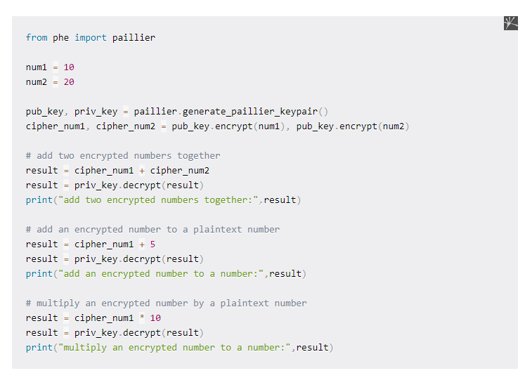
Homomorphic Encryption Implementation
Paillier Cryptosystem
The Paillier Cryptosystem was invented by Pascal Paillier in 1999. It is a Partial Homomorphic Encryption (PHE) scheme and Additively Homomorphic.
It supports only the addition of two ciphertexts and not the multiplication between them. Also, a plaintext number can be added or multiplied to the ciphertext.
In this example we use python-paillier, a Python library for Partially Homomorphic Encryption using the Paillier cryptosystem.

Slide 15


In the example above we generated a key pair of a public and a private key. Next, we encrypted both num1 and num2 with the public key and performed operations on their ciphertexts.
First, we added the two ciphers. After that, we took the cipher_num1 and added to it a plaintext number. Last, we did the same process as before, but instead of addition, we multiplied the cipher_num1 with a plaintext number this time.
The calculation of these operations takes place while the data is encrypted. Also, we can verify the integrity of the result each time by decrypting it using the private key.

Slide 16
Conclusion
Homomorphic encryption offers a transformative approach to data privacy and security. With ongoing advancements and collaborative efforts, its potential to revolutionize secure data processing is within reach.

Slide 17
Thanks!

